Slide 1


Team Smart Trash Bin:
Product for Recycling Contamination Presented by:
Kwabena Arthur, Michael Chan, Heather Furman, Homam Meaddawi, Efstratios Moskofidis, Win Vorapanyasakul, Lili Zhao, Bowen Zeng

Slide 2
Mission Statement:
Promote contamination-free recycling
Product Description | A recycling bin that effectively reduces one of the main types of contamination: Food, Plastic film, and Hazardous materials
Benefit Proposition | Improve the acceptance rate of recycled items Reduce contamination from trash items Optimize recycling processes
Key Business Goals | Reduce contamination to 5% (A rate) Reduce cost of processing recyclables by 20% Better waste management education for users
Primary Market | Food - Commercial / institutional Plastic film - Residential
Assumptions and Constraints | Resources accessibility to water and electricity Ability to change sustainability behavior of stakeholders
Stakeholders | Recycling companies, waste managers, property owners, users

Slide 3
Critical Customer Needs
Individual User
Commercial / Institution
Recycling Processor
The product clearly communicates what kind of recyclables it can receive
The product enables sorting items out of mixed bag or container
The product can be one-hand operated
The product eliminates contamination fines
The product reduces custodial labor
The product contributes to inventory and other operational cost optimization
The product contributes to maintaining a good relationship with the trash contractor
The product leads to less recyclables sent to landfill
The product enables recycled products with higher quality
The product contributes to cost- and time-efficiency in the recycling process
The product increases safety at work

Slide 4
Key Innovations
Individual Person
Commercial / Institution
Recycling Processor
Offloads burden of sorting from users
No required change in behavior
No longer have to pay exorbitant contamination fines
Easily updatable list of recyclables
Easier, cheaper recycling
Fewer machine jamming incidents
Concept 1: Artificial Intell. Recycling Bin
Concept 2: Cleaning Recycling Bin
User does not have to worry about cleaning container before recycling
No longer have to pay for exorbitant contamination fees
Reduce custodial labor
Easier, cheaper recycling
Concept 1:
AI Recycling Bin
Higher chance to eliminate major sources of recyclables contamination
Higher recycle rate
Concept 3: Additional Bin
Easy behavioral change
Waste management education on the way
Easier, cheaper recycling

Slide 5
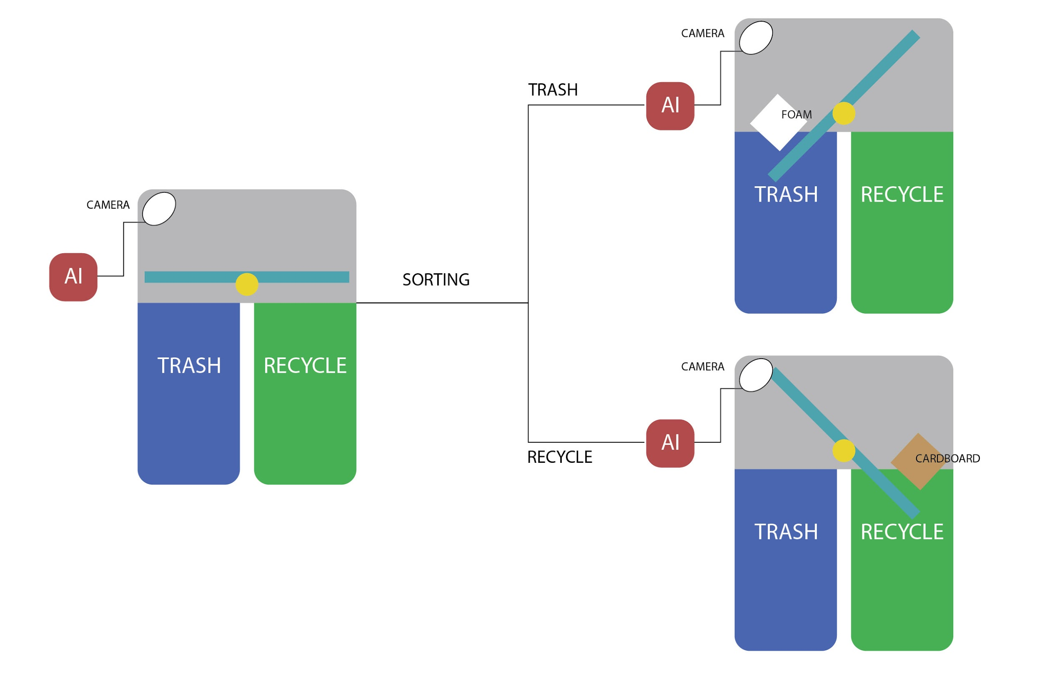
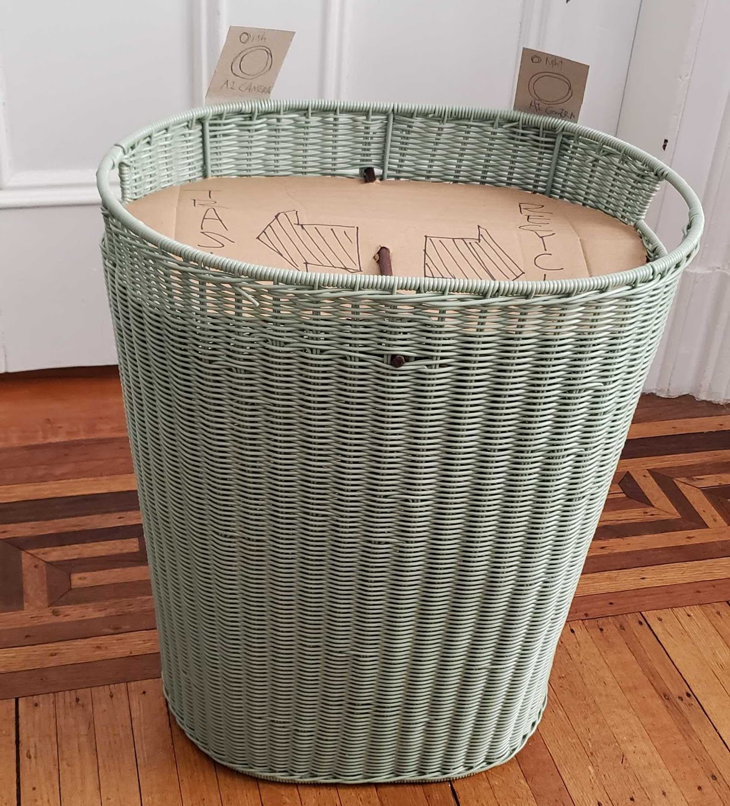
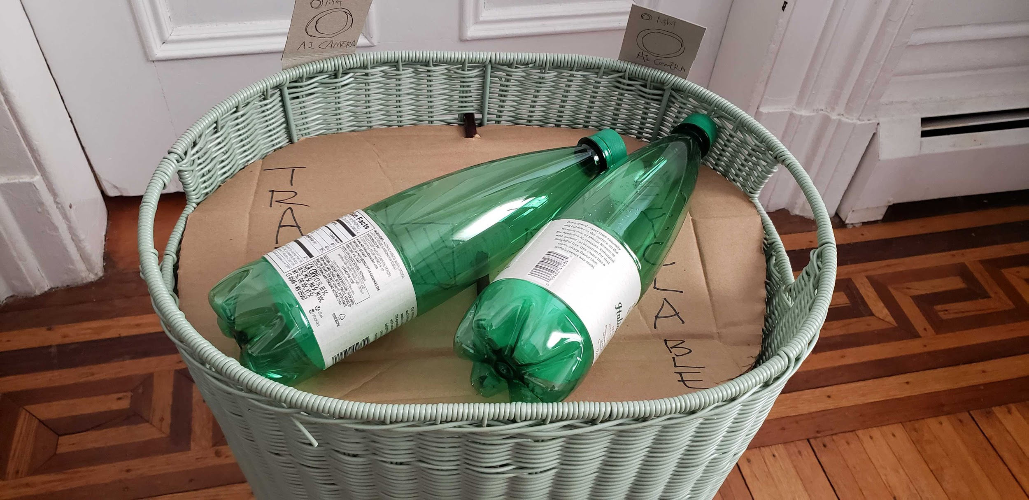
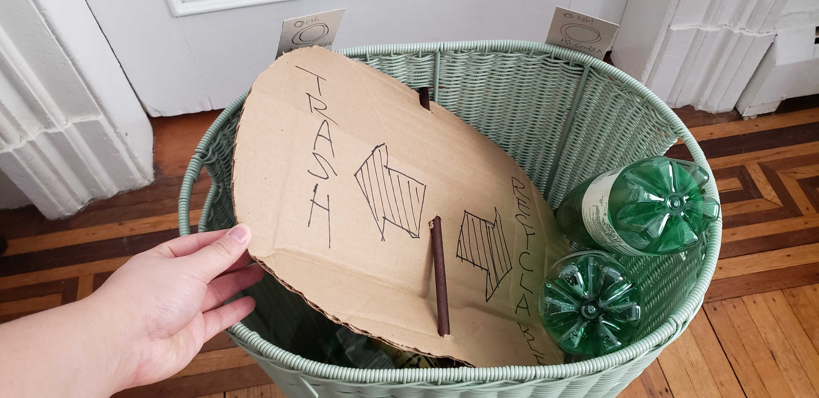
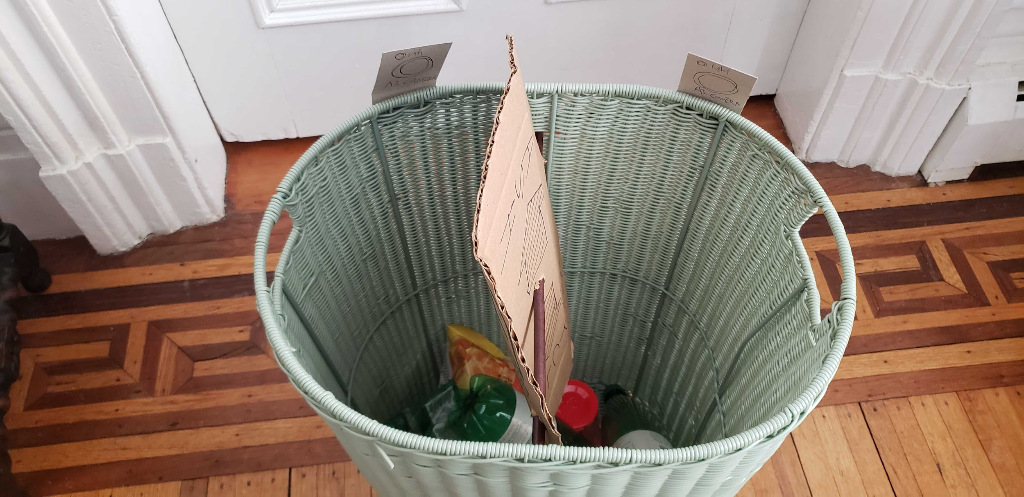
Concept 1: Artificially Intelligent Recycling Bin
Leveraging AI (Computer vision) to eliminate contamination from sources
Notes:
The main issue of contamination arises when people assume things are recyclable, when in truth, they are not.
One concept is simple: don’t trust humans: have a smart recycling bin that will throw-out anything that is not recyclable.
To do this, we will use

Slide 6
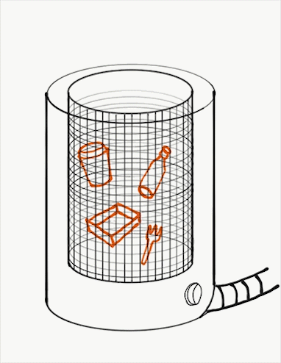
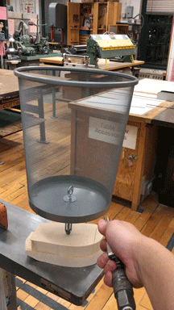
Concept 2: Object-cleaning Recycling Bin
Self-cleaning recycling bin to reduce contamination. Using water or air to remove residue from recyclable items. Think washing machine, but in a trash can.
Food court case
Food residue contamination
Liquid residue contamination
Other Trash contamination

Slide 7
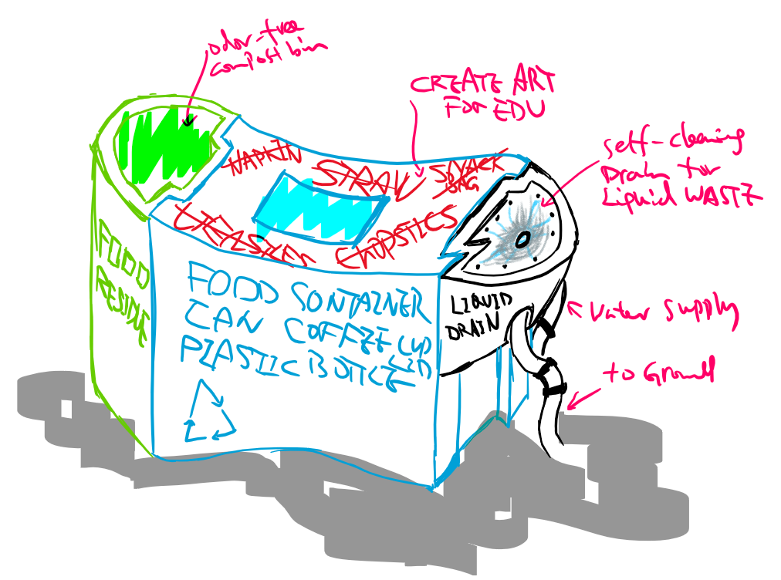
Concept 3: Extra Bin for Isolating a Major Specific Contaminant
Modularized recycle bin combination to tackle major contamination sources under various application
Food court case
Food residue contamination
Liquid residue contamination
Other Trash contamination
Residential case
Plastic bag/film contamination
Batteries and/or electronics
Hangers

Slide 8
Key Uncertainties
Concept 1: Artificial Intell. Recycling Bin
Need to understand the access to electricity to commercial / institutional locations
Need to ensure that this will not intimidate users
Need to ensure machine / code runs quickly enough so that it doesn’t make the user wait too long to recycle
Need to ensure high accuracy
Concept 2: Cleaning Recycling Bin
Need to understand the access to plumbing for commercial / institutional locations
Need to better understand the degree to which items need to be cleaned
Need to find a way to separate cardboard from plastic and metal before washing
Capped bottles could not potentially be cleaned - does this matter?
Concept 1:
AI Recycling Bin
Concept 3: Additional Bin
Need to understand if users will be compliant with another bin
Need to route the contents of the container to the proper receptacle
Need to think about distribution channel and how we get bins in the hand of consumers

Slide 9
Thank You
“It’s trash-can, not trash-cannot”

